Slide 1

Horizon Forecast
Satellite Cloud IR Nowcasting Transformer Model
CODE: 26-1-R-1
Presenting:
Or Mordechay Hod
Gilad Boudman
Advisors:
Mrs. Elena Kramer
Dr. Dan Lemberg

Slide 2
Current Models
NWP Models
Standard Model
physics models are very accurate but too slow
fast, but they produce 'Blurry' forecasts
Notes:
So let's start with why we need it. With current climate changes, we see an increase in extreme storms and a decline in steady, moderate rain. So What we have today are two types of models. The first are physics models that do a lot of calculations before a prediction. This makes them really accurate but really slow at giving an output. The second type of models are fast but give less accurate prediction.

Slide 3
Project Goals
Physics-Informed
Cascaded Network
Understand the wind and temperature evolution over time
First understand why then where
Notes:
Let's move to our project and what our goals are. Our idea is to create a physics-informed model that doesn't just gusses where the next pixel on the map should be colored. but a model that understands why the storm is moving this way or the other, and how it's going to evolve over time. We also want to test and research if a cascaded network—which means first predicting physics drivers, then clouds, and at the end rain—is the solution for this.

Slide 4
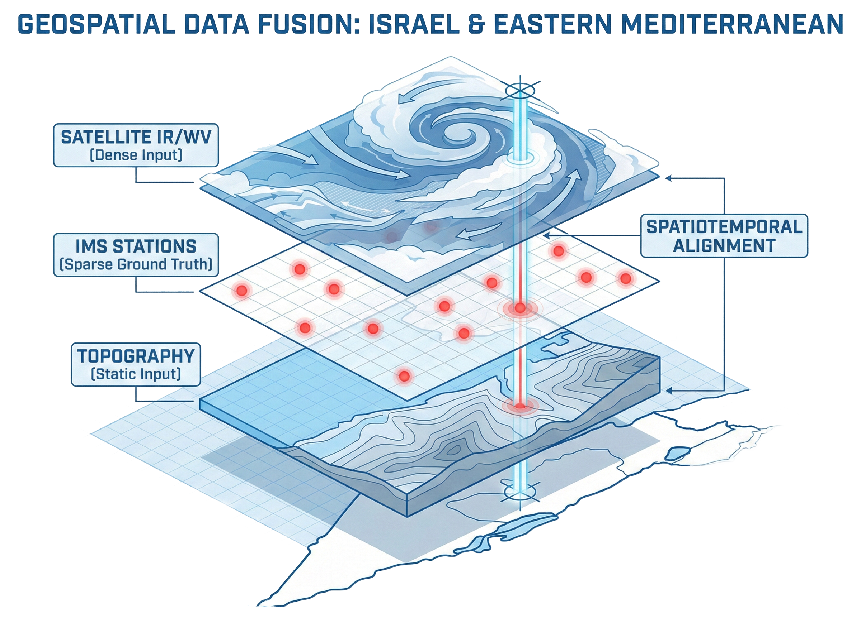
Data Sources
Notes:
so let's talk about all the data we plan to feed the model. First, we have our satellite images. At every time step, we are going to feed the model a TIFF file containing Thermal Infrared and Water Vapor data around the area of Israel. Second, we have a topography map that will help the model understand how the mountains and valleys impact the cloud and rain formation around the area. And lastly, we have the coordinates of each active IMS that we pull the ground truth data from.

Slide 5
Expected Challenges
Synchronization
Class Imbalance
Missing Data
Images every 15 minutes,
Ground truth every 10 minutes.
Only 1.2% of the days had rain in the last 5 year
Large time gaps
Sparse Ground Truth
Few ground stations
Notes:
We expect to have a few challenges that we will need to overcome. The first is synchronization. The satellite images we are acquiring are every 15 minutes, but the data from the IMS is every 10 minutes. We plan on building a protocol to fill the small gaps between the data. If it happens that there is a time gap caused by missing data from the satellite images or if a station didn't record the data for more than 30 minutes, we will dump data around that time so we will keep the training pure and without gaps.
And the tired, in the last 5 years, there was only 1.2% of days where there was an amount of rain that could be recorded by the IMS. To solve this problem, we plan on giving a prediction of a storm correctly a higher value than predicting a sunny day, and we will punish the model a lot harder for missing a storm. And we come to the last problem, which is that to train the model you need ground truth, and in Israel, we have reliable data only in places where there is an Israel Meteorological station or IMS.

Slide 6
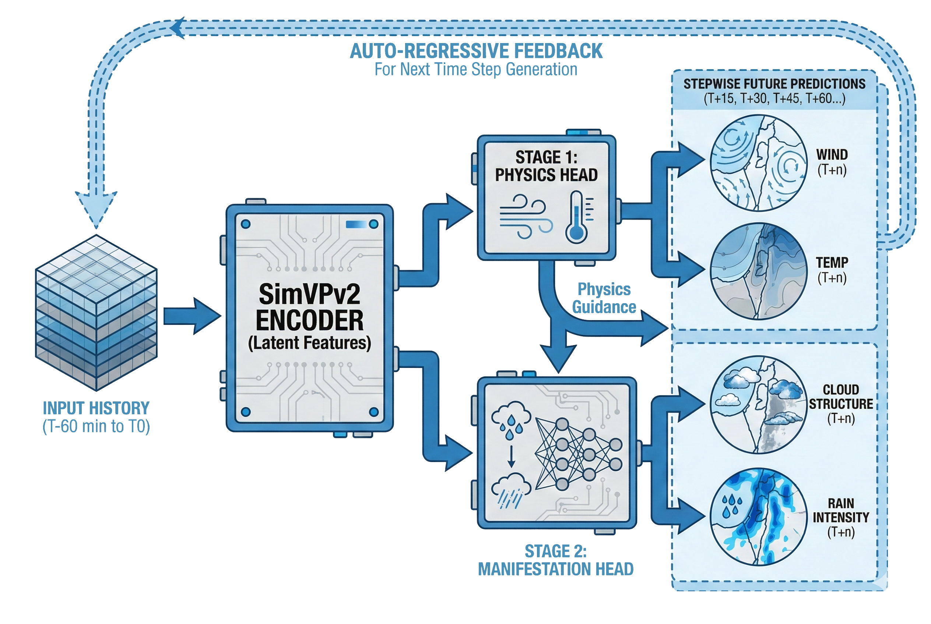
The Solution – Architecture Overview
Notes:
Our solution is a Hybrid Cascaded Architecture.
We want to use the strengths of two state of the art models – SimVPv2 and SaTformer in our architecture to create a better solution for the stated problems.
First, we use SimVPv2 Encoder as our backbone for its spatial efficiency, it acts as our feature extractor.
Then we will move to the 1 stage where we will predict the physical drivers such as wind and temperature.
And lastly, we will move to stage 2 where we will split paths where one path uses SimVPv2 ideas and the other is inspired by SaTformer.

Slide 7

Stage 1 – The "Physics" Drivers
Drivers
Masked Loss function
Surface wind and temperature
$$ℒ_{drivers}=\frac{1}{N_{active}}\sum_{\left(x,y\right)∈Mask}{{\left(Y_{station}^{\left(x,y\right)}−\hat{Y_{pred}^{\left(x,y\right)}}\right)}^{2}}$$
Notes:
Like we said most AI weather models try to predict rain directly from satellite images, we believe that this might be a mistake because it forces the model to guess where the storm is going without understanding why it moving.
In our approach we force the model to first predict the thermodynamic causes – the Surface Wind, which can give us the direction and the Temperature, which can give an idea about its intensity for example.
Now, we have an issue, we only have ground truth for these drivers at specific IMS coordinates.
To solve this, we intend to implement a Masked Loss Function.
We will only calculate errors at the active stations, and since wind and temperature are continuous fields, we can rely on the spatial continuity of CNNs to fill in the gaps and map the grid.

Slide 8


Stage 2 – The Y Path Structure
SaTformer Classification
64 probability classes
$$ℒ_{class}=−\sum_{c=0}^{63}{w_{c}}⋅y_{true,c}⋅\log\left(\hat{p_{c}}\right)$$
Class Weighted Cross Entropy Loss
$$ℒ_{clouds}=\frac{1}{H×W}\sum_{i=1}^{H}{\sum_{j=1}^{W}{{\left(Y_{true_img}^{\left(i,j\right)}−\hat{Y_{pred_img}^{\left(i,j\right)}}\right)}^{2}}}$$
Clouds Structure
Notes:
Moving to stage 2, our architecture splits into a Y path structure with two distinct heads.
The first head is the Rain classification that is inspired by the SaTformer model, the idea is to treat the weather forecasting as a classification problem.
We will classify the pixels into 64 “Intensity Buckets” with a class weighted cross entropy loss function, we do this to force the model to pay extra attention to the rare events.
The second head is the cloud structure prediction, here we will use an MSE based loss function to force the model to generate sharp and realistic cloud textures.
By combining these two paths, we can get a forecast that is both accurate in intensity and visually clear.

Slide 9

Loss Function
Total Loss Function
$$L_{total}=λ_{visual}ℒ_{clouds}+λ_{drivers}ℒ_{drivers}+λ_{rain}ℒ_{class}$$
Notes:
We talked about each of the loss functions that we use for each stage.
Now, to train the entire system we define our Total Loss as a weighted sum of the three components that we talked about,
while the lamda weights allow us to balance the competing goals of each component.

Slide 10



Metrics & Success Criteria
$$\sqrt{\frac{1}{N}\sum_{i=1}^{N}{{\left(Y_{true}^{\left(i\right)}−Y_{pred}^{\left(i\right)}\right)}^{2}}}$$
RMSE
$$\frac{\left(2μ_{x}μ_{y}+C_{1}\right)\left(2σ_{xy}+C_{2}\right)}{\left(μ_{x}^{2}+μ_{y}^{2}+C_{1}\right)\left(σ_{x}^{2}+σ_{y}^{2}+C_{2}\right)}$$
SSIM
$$\frac{Hits}{Hits+Misses+FalseAlarms}$$
CSI
HSS
$$\frac{2\left(Hits⋅CorrectNeg−Misses⋅FalseAlarms\right)}{\left(Hits+Misses\right)\left(Misses+CorrectNeg\right)+\left(Hits+FalseAlarms\right)\left(FalseAlarms+CorrectNeg\right)}$$
Notes:
We decided to evaluate the model using 4 different metrics.
For the drivers we decided to use RMSE – we chose it because the squared error heavily penalizes large errors or outliers (rare event).
For the cloud structures we use SSIM because this metric measures structure, contrast and texture which will help us to verify how sharp and realistic are our clouds.
For the rain alerts we will use both CSI which will ignore Correct Negatives (no rain correct prediction) and focus on hits vs misses of each of the classes, and HSS to prove that the model performs better than a random guess.

Slide 11
Testing Plan
Baseline Comparison
SOTA Comparison
Case Study
A model that predicts the weather will be the same
Is a hybrid model more efficient than SaTformer
Is our cascading architecture necessary
Notes:
So let's talk about our testing plan. We plan three tests to prove our model really works. The first test is a baseline comparison. We will take a 'model' that predicts that the next weather will be exactly the same as current. This will let us see that the model really think and not just predicting the same weather every time. Second, we take our model and will compare it to the model we are basing the transformer on, 'SaTformer'. This will let us see how our model compares exactly to an award-winning model. And the third test we are going to do is to take our model and test how it works in predicting the weather when you cut the information about the thermodynamic drivers to see if we really need the cascading architecture.

Slide 12
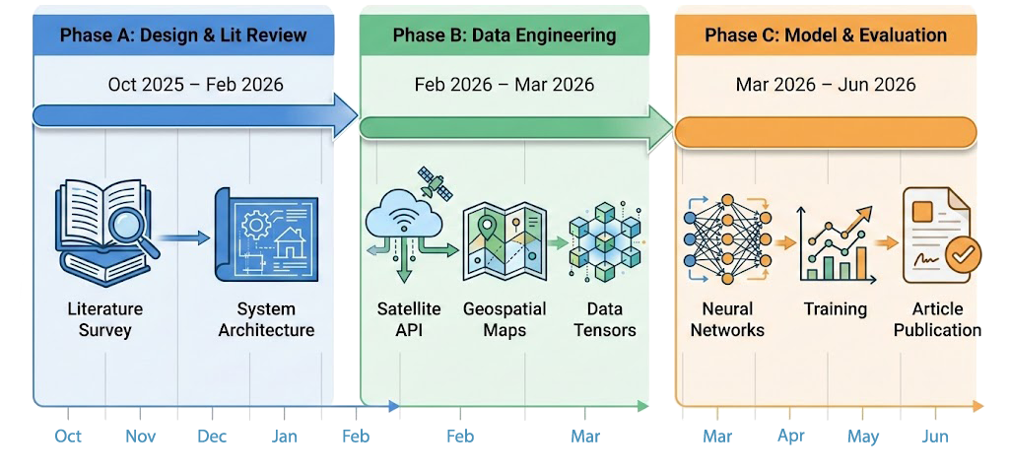
Gantt
Notes:
So after we talked about the model, let's talk a bit about our project timeline. We started our journey around the end of October, where we started with a literature review and survey of our idea. Next, we started designing the system architecture, what the model should do, and understanding our hypothesis. The next part we are entering until the start of the next semester is collecting all the data we will need for training and testing. Starting next semester, we are going to create the model, train it, and test it. And at the end, we will show you our findings about if our plan worked and if our model really succeeded.

Slide 13
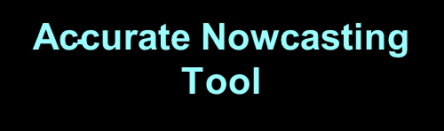
Summary
Hybrid Architecture Physics First
$\text{Accurate}$ Nowcasting Tool
Notes:
So lets summarize. we have seen that current models are either slow and need a lot of computing time or inaccurate .
we have designed a new hybrid architecture model idea that will first “learn physics” and then predict the rain.
We predict our idea will create a scalable and more accurate nowcasting tool that will allow even further improvements in the field of nowcasting to give warnings in time and help people.

Slide 14
Thank You Questions?

